Slide 1
Versatile Geometric Flow Visualization
by
Controllable Shape and Volumetric Appearance
Mahmoud Zeidan^{1,2}, Christoph Peters¹, Tobias Rapp¹, and Carsten Dachsbacher¹
¹Computer Graphics Group, Karlsruhe Institute of Technology, Germany
²Faculty of Computer and Information Sciences, Ain Shams University, Egypt
Notes:
Welcome to our presentation
In this presentation we present our work for flow visualization
This work is made by from KIT, Germany

Slide 2
Motivation
3D flow visualization
Geometry (e.g., streamlines, streamribbons, streamsurfaces)
Texture-based (e.g., 3D-LIC)
Feature-based (e.g., Tensor field flow visualization)
Combine different approaches
Geometry based
Volumetric approximation
Real-time / interactive visualization
Notes:
Flow visualization cab be categorized to 3 main approaches: 1. Geometry based flow visualization such as streamlines, streamribbons and streamsurfaces
2. Texture based flow visualization such as 3D-LIC visualization
3. Feature based flow visualization such as Tensor flow visualization Our proposed solution presents a visualizion framework that combine different flow viualtion approaches
Our soultion is mainly geometry based approach based on rasteraiaztion pipline
This make our vizualiation acheives realtime or interactiove performace
We also provide an approximate way for volutemtic viuation that akllowed us to

Slide 3
System overview
Longitudinal kernel
Transfer function
Vector field
Streamline integration
Geometry extrusion
Geometry
Rendering
Output image
Cross-sectional shapes
Transmittance LUT
Geometry generation
Notes:
Our visualizaion pipline has two main phases
First starting with vector field date we generate flow geomtry
In prenciple we start with VF integation and the we extruse streeam geomtry wirh 2D cross-sectional glyphs
In the second phase we use state of the art OIT for semi-transparent geoemtry rendering

Slide 4
Streamlines generation
Trace independent particles inside vector field
4th -order Rung-Kutta
Bind volume into 3D texture
Using CUDA®
Notes:
At the beginning we intergates vector filed using 2 paralllel paricles perpendicale to flow direction
Using CUDE and a 4th oder RK
We acceleate this process via 3D tetxure samplign within the voume

Slide 5
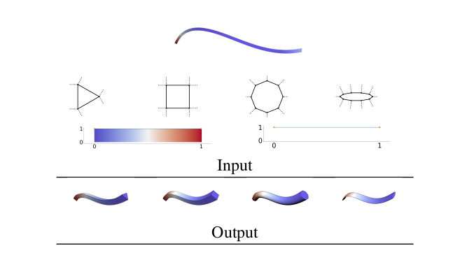
Cross-sectional glyphs
User place arbitrary cross-sectional glyphs along attribute range
Extrude 2D-glyphs
Notes:
The used design simple 2D glyphs
These glyphs these 2D Glyphs are places at different regions of input data range
In this figure we show 4 different glyphs extruded over a streamline

Slide 6
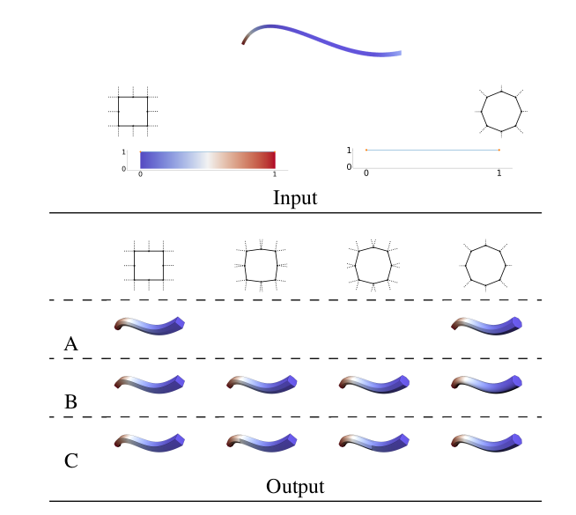
Glyphs morphing
Interpolation between corresponding vertices
Linear interpolation
Modes of interpolation
Notes:
We also allows the used to interpolate between two neignboring glyphs
We present 3 modes of shpe morphing and interpoaltion
Firat we can nterpolate between tow nsh
Second we can use and instant of interpolation over that whole streamline
Thirdyl we can devide a region into two segment the left part is extruded with left shpe and the right part is extrued with right shape

Slide 7
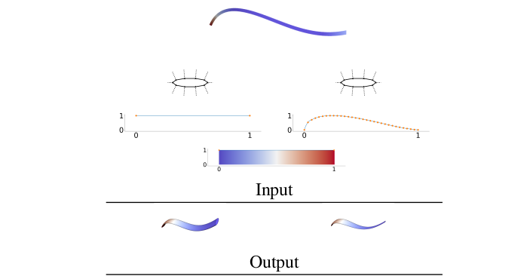
Longitudinal kernel
1D Texture
Notes:
To contol the extrustion with we uase a 1D kerenrl for cross section shape radius over doamin range
This way we are able to visuatioze deictional flow within the data

Slide 8
Triangles mesh
Use CUDA
Triangle soup (vertex buffer, index buffer)
Computed
Count aggregate number
Notes:
Once the user defined cross-sectional glyphs, longitual kernal and interpolation method
We used extusion to generate triangular mesh
The gemetry size is defived diretly form the cross-section glyphs size and streamline length
We use CUDA to acheve inteative or realtime respones

Slide 9
Rendering
PBR model
Point light sources
Material color via user or TF
Black outlines in the spirit of NPR
Transmittance equation ...

Slide 10
Semi-transparent geometry rendering
MBOIT
Transfer function
Geometry
First pass
Moment buffers
Second pass (compositing)
Output image
Transmittance LUT
Transmittance
approximation
Semi-transparent rendering with MBOIT

Slide 11
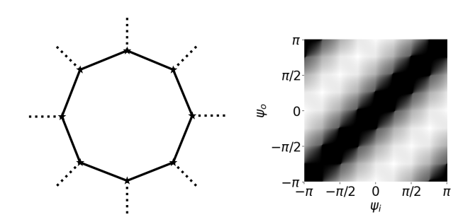
Volumetric aproximation
2D, 3D texture

Slide 12
Results
Intel i7-6700 CPU with 3.40~GHz
32~GB of main memory,
NVIDIA GTX 1080~Ti GPU with 11~GB VRAM
Real and synthetic 3D vector field data sets
Full HD image size

Slide 13
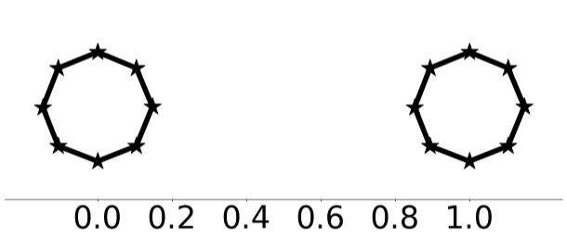
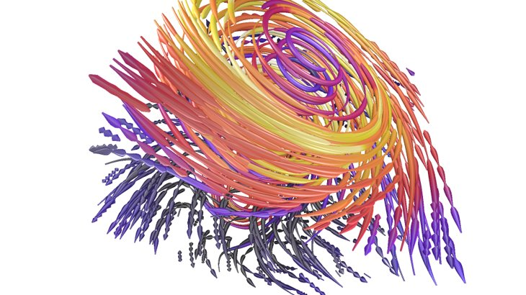
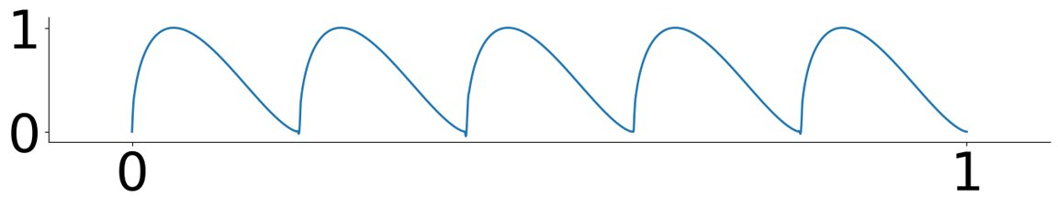
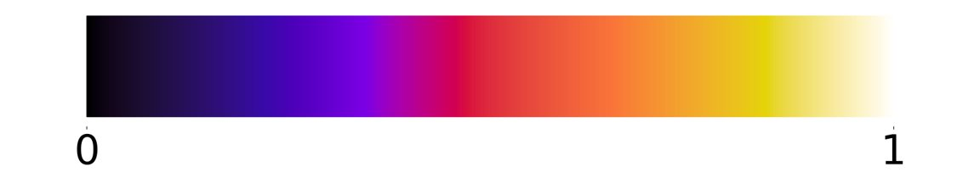
Directional kernel
Flow direction

Slide 14
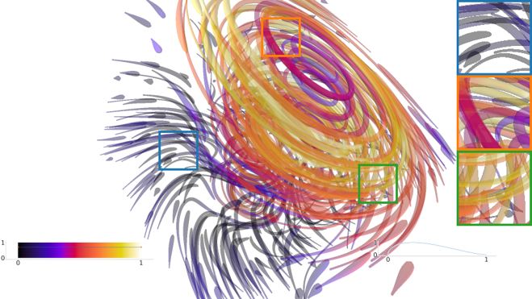
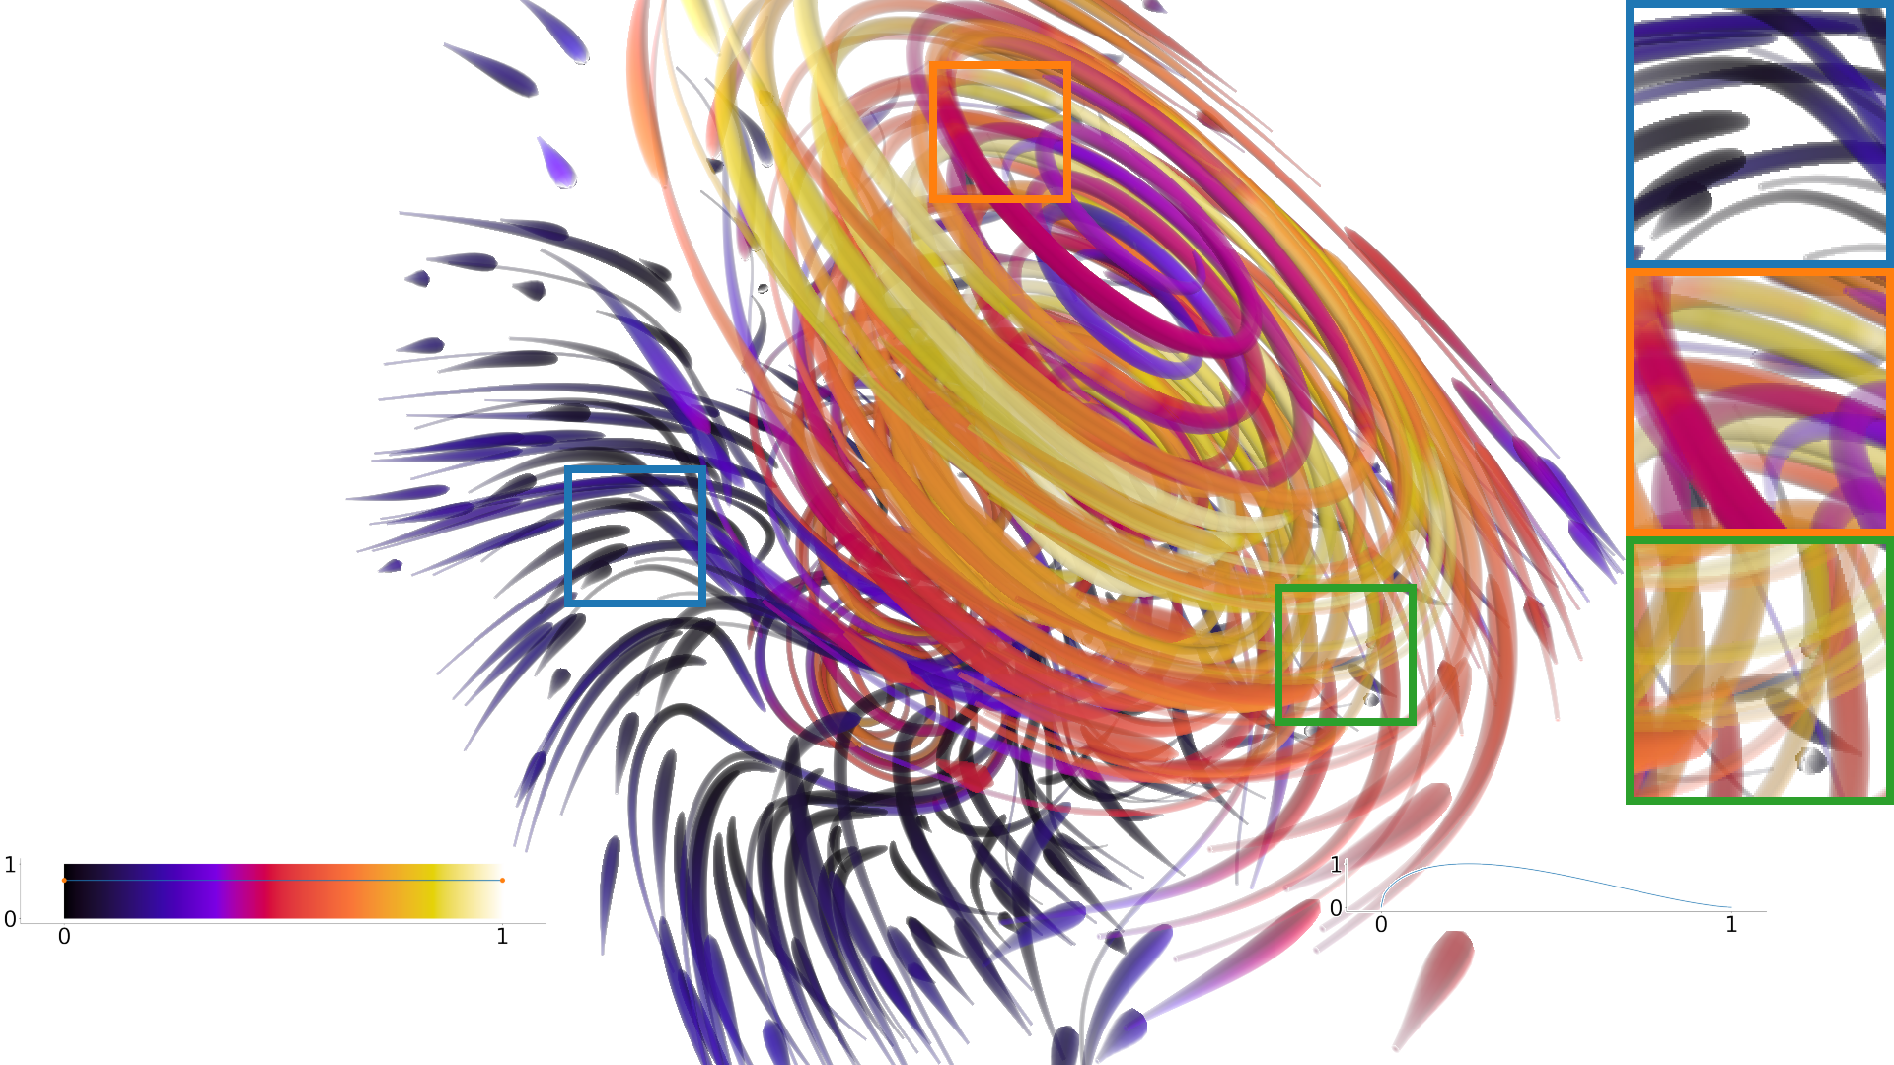
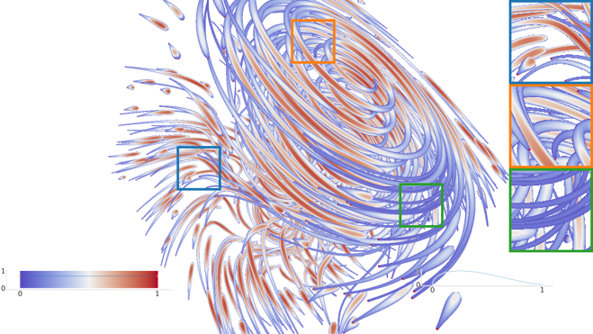
Volumetric Approximation
Cross-section approximation
:

Slide 15
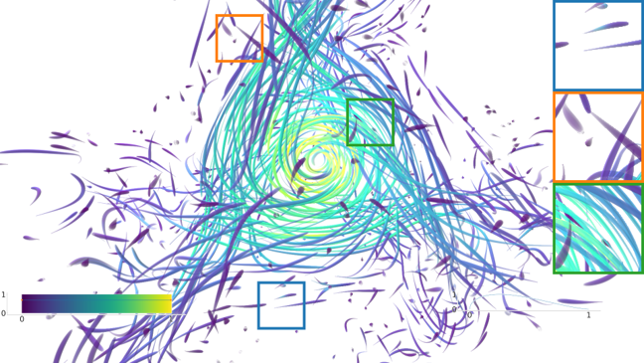
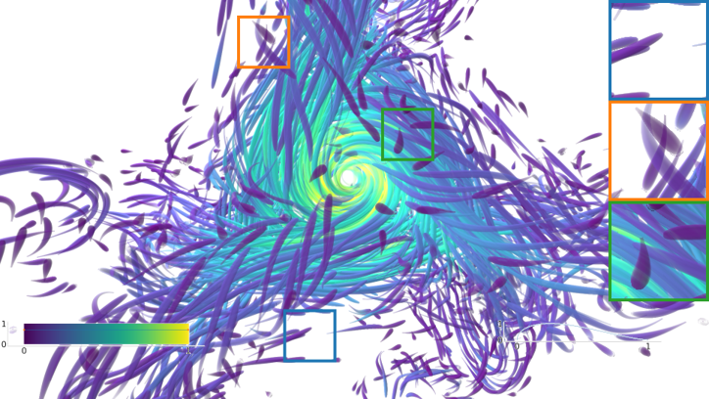
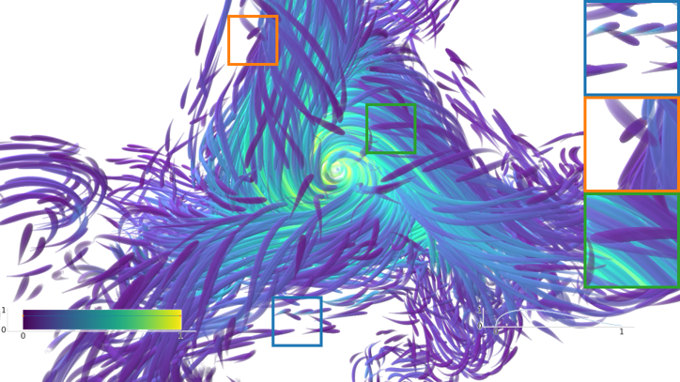
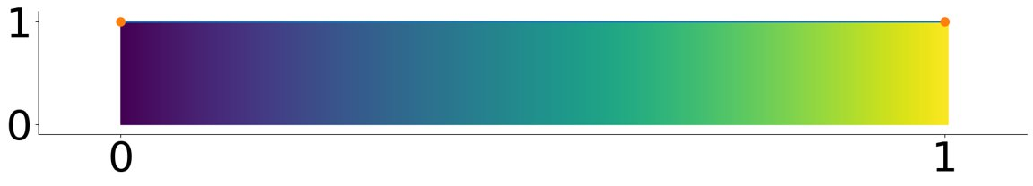
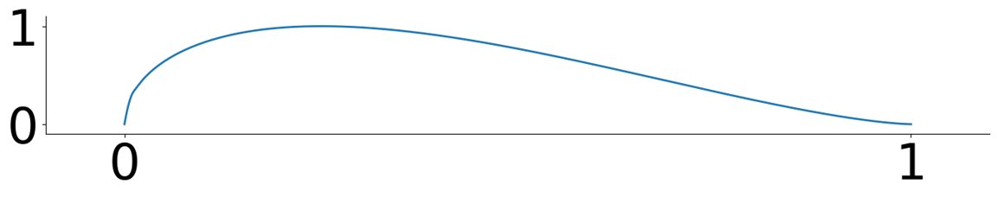
Scalability
Increasing geometry

Slide 16
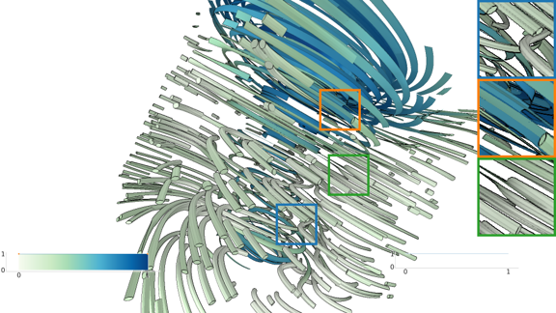
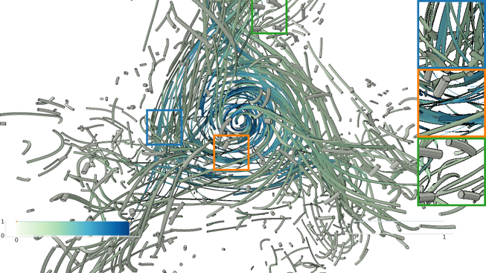
Region of interest selection
Important region

Slide 17
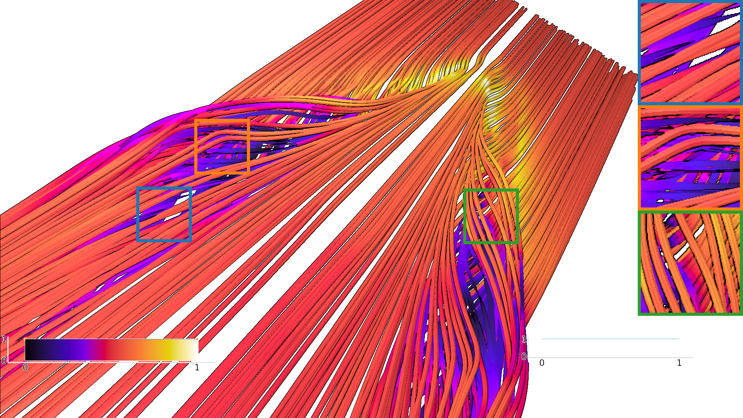
Rotational component

Slide 18
Conclusions
Geometry-based flow visualization technique
Encode vector field directional and rotational component
Mimic 3D volumetric appearance
Limited in cluttered regions

Slide 19
Future work
Automate placement of cross-sectional glyphs
Automate cross-sectional shape morphing

Slide 20
Thank you
Questions

